Slide 1
Chapter 16: Virtualization
Virtual means never knowing where your next byte is coming from.
—Unknown

Slide 2
Chapter Outline
Shared Resources
Virtual Machines
Containers and Pods
Serverless Architecture
Summary

Slide 3
Shared Resources
The goal of virtual machines and containers is to isolate one application from another, while still sharing resources.
Resource sharing can dramatically lower the costs of deploying a system.
There are four resources that we typically care about sharing:
Central processor units (CPUs)
Memory
Disk storage
Network connections

Slide 4
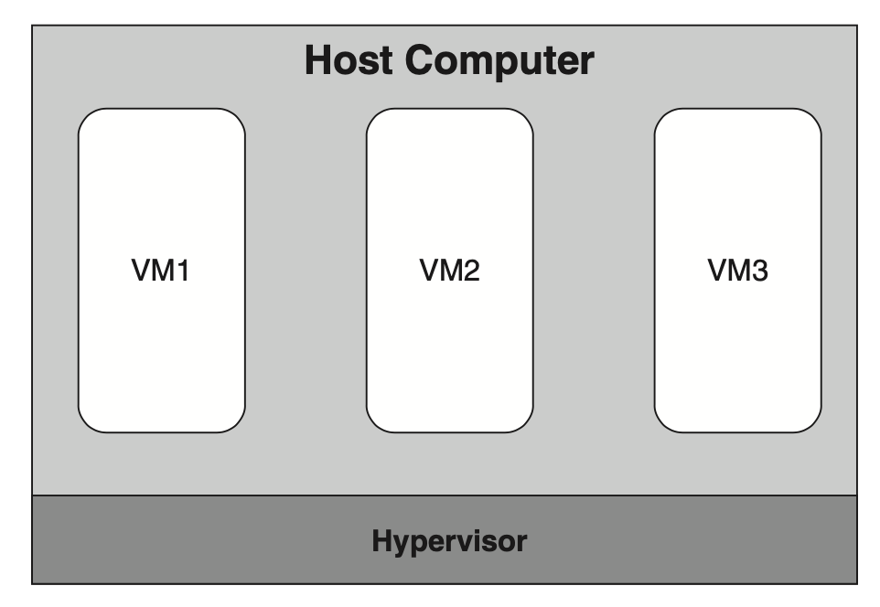
Virtual Machines
The physical computer is called the “host computer”; the VMs are called “guest computers.” The hypervisor is an OS for the VMs. This hypervisor runs directly on the physical computer hardware and is often called a bare-metal or Type 1 hypervisor
The VMs that it hosts implement applications and services.

Slide 5
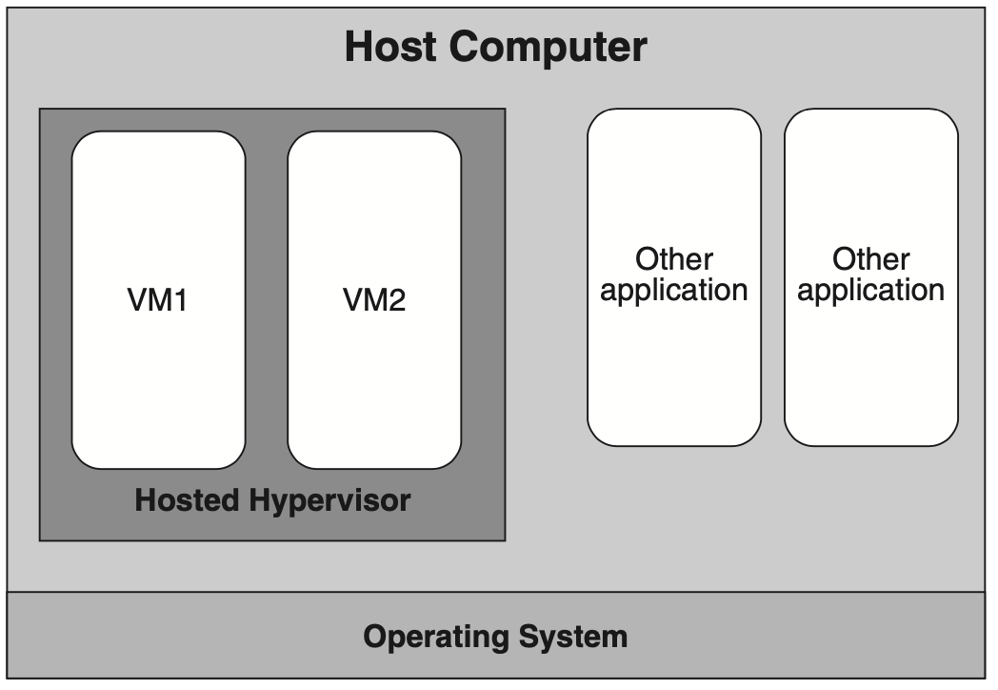
Virtual Machines
Another type of hypervisor is a hosted or Type 2 hypervisor which runs as a service on top of a host OS.
The hypervisor in turn hosts one or more VMs. Hosted hypervisors are typically used on desktop or laptop computers.

Slide 6
Virtual Machines
A hypervisor performs two main functions:
It manages the code running in each VM, and
it manages the VMs themselves.
Code that communicates outside the VM by accessing a virtualized disk or network interface is intercepted by the hypervisor and executed by the hypervisor on behalf of the VM.
VMs must be managed, e.g. created and destroyed.
From the perspective of the OS and services inside a VM, it appears as if the software is executing inside of a physical machine. The VM provides a CPU, memory, I/O devices, and a network connection.

Slide 7
Virtual Machines
The hypervisor is a complicated piece of software.
One concern with VMs is the overhead introduced by the sharing and isolation needed for virtualization.
Implications for the architect:
Performance. Virtualization incurs a performance cost.
Separation of concerns. Virtualization allows an architect to treat runtime resources as commodities, deferring provisioning and deployment decisions to another person or organization.

Slide 8
VM Images
We call the contents of the disk storage from which we boot a VM a VM image.
You can build a VM image on your development computer and then deploy it to the cloud.
VM images are large, so transferring them over a network can be slow.
It is customary to create images that contain only the operating system and other essential programs, and then add services to these images after the VM is booted, in a process called configuration.

Slide 9
Containers
VMs solve the problem of sharing resources and maintaining isolation. But VM images can be large, and transferring them is time-consuming.
Containers maintain most of the advantages of virtualization while reducing the image transfer time and startup time.
Like VMs and VM images, containers are packaged into executable container images for transfer.

Slide 10
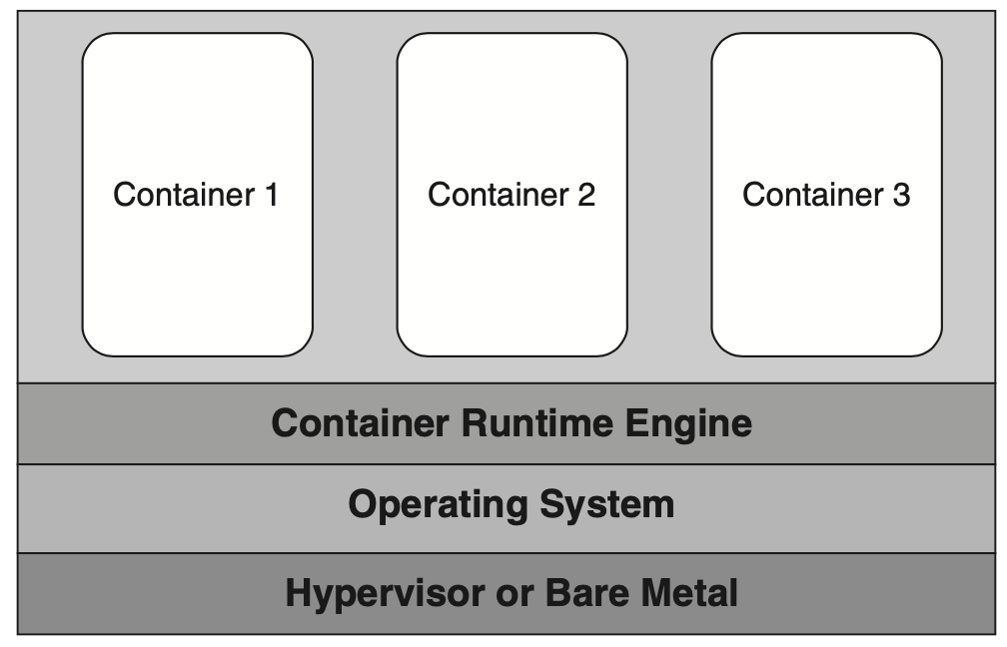
Containers
Containers operate under the control of a container runtime engine, which runs on top of a fixed OS.
The container runtime engine acts as a virtualized OS.
The OS can be loaded either onto a bare-metal physical machine or a virtual machine.
Containers are allocated by finding a container runtime engine that has sufficient unused resources to support an additional container.
Containers impose some restrictions on port usage.

Slide 11
Containers
This sharing of the OS is a source of performance improvement.
As long as the target machine has a standard container runtime engine running on it, there is no need to transfer the OS as part of the container image.
Another source of performance improvement is the use of “layers” in the container images.

Slide 12
Containers versus VMs
What are the tradeoffs between delivering your service in a VM and delivering your service in a container?
The software that you run on the VM includes an entire OS.
This allows you to run multiple services in the same VM—a desirable outcome when the services are tightly coupled or share large data sets.
Container instances share an OS.
Containers generally run a single service so the size of the container image is small.
Containers are portable.
VMs persist beyond the termination of services running within them; containers do not.

Slide 13
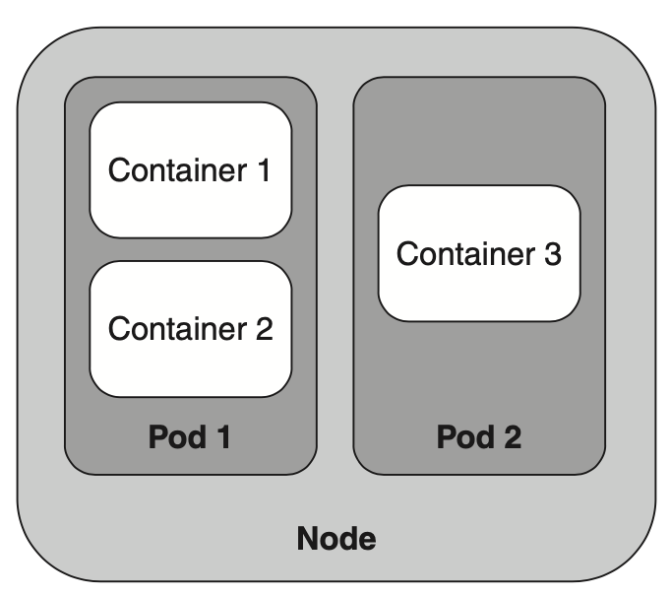
Pods
Kubernetes is orchestration software for deploying, managing, and scaling containers.
It has one more element in its hierarchy: Pods.
A Pod is a group of related containers.
In Kubernetes, nodes (hardware or VMs) contain Pods, and Pods contain containers.

Slide 14
Serverless Architecture
Serverless architectures are not, in fact, serverless.
There are servers, which host container runtime engines.
Containers are allocated dynamically with each service request. And they are cached, to improve performance (after initial load). These containers are typically stateless.

Slide 15
Summary
Virtualization has been a boon for software and system architects, as it provides efficient, cost-effective allocation platforms for networked (typically web-based) services.
Hardware virtualization allows for the creation of several virtual machines that share the same physical machine. It does this while enforcing isolation of the CPU, memory, disk storage, and network.
Consequently, the resources of the physical machine can be shared among several VMs, while the number of physical machines that an organization must purchase or rent is minimized.

Slide 16
Summary
A VM image is the set of bits that are loaded into a VM to enable its execution.
Containers are a packaging mechanism that virtualizes the operating system. A container can be moved from one environment to another if a compatible container runtime engine is available.
Placing several containers into a Pod means that they are all allocated together and any communication between the containers can be done quickly.
Serverless architecture allows for containers to be rapidly instantiated and moves the responsibility for allocation and deallocation to the cloud provider.

